Slide 1
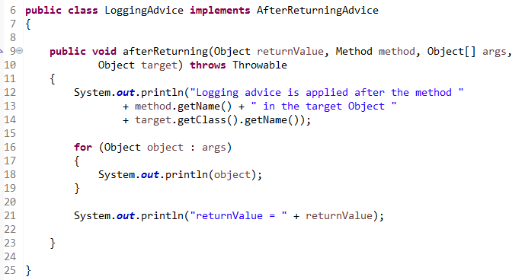
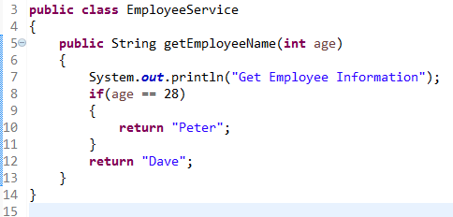
BeforeAdvice Example
After Advice is executed after the actual method call. If method returns a value, it is executed after returning value.
method
After Advice
2
1

Slide 2
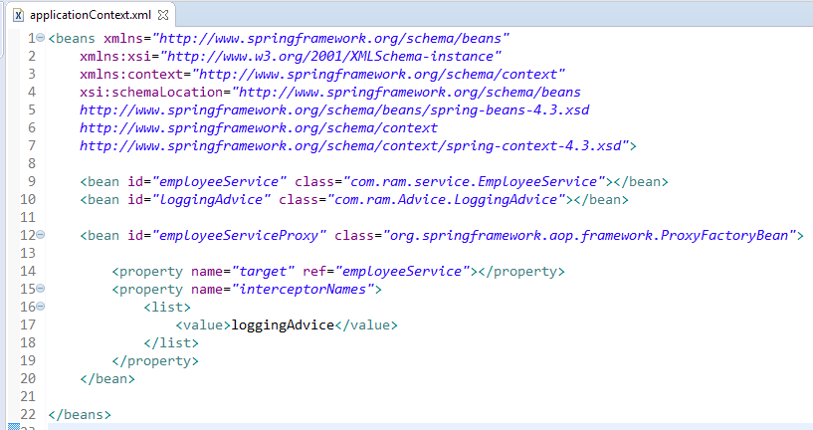
BeforeAdvice Example
In xml file, create 3 beans, one for EmployeeService class, second for LoggingAdvice class and third for ProxyFactoryBean class.
The ProxyFactoryBean class is provided by Spring Famework. It contains 2 properties target and interceptorNames. The instance of EmployeeService class will be considered as target object and the instance of LoggingAdvice class as interceptor.

Slide 3
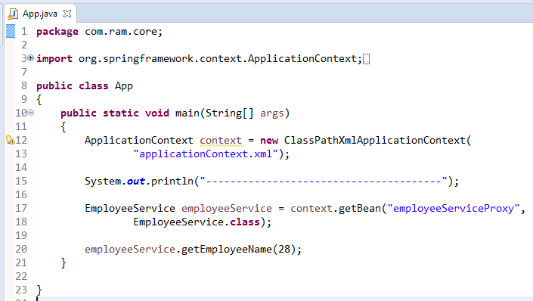
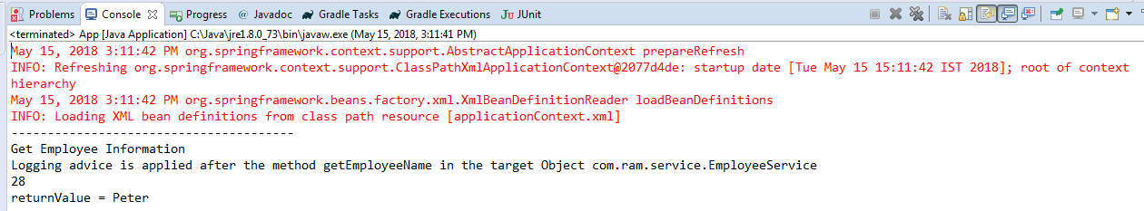
BeforeAdvice Example

